Slide 1
Draft Graphs DP

Slide 2
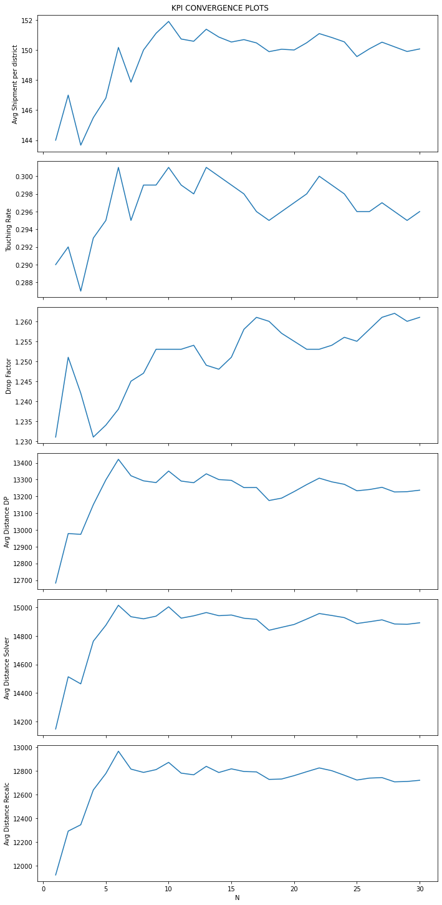
Evaluation of Convergence of KPI values for sizes of N
KPI_Warmsen_31604-09_Monday_100

Slide 3
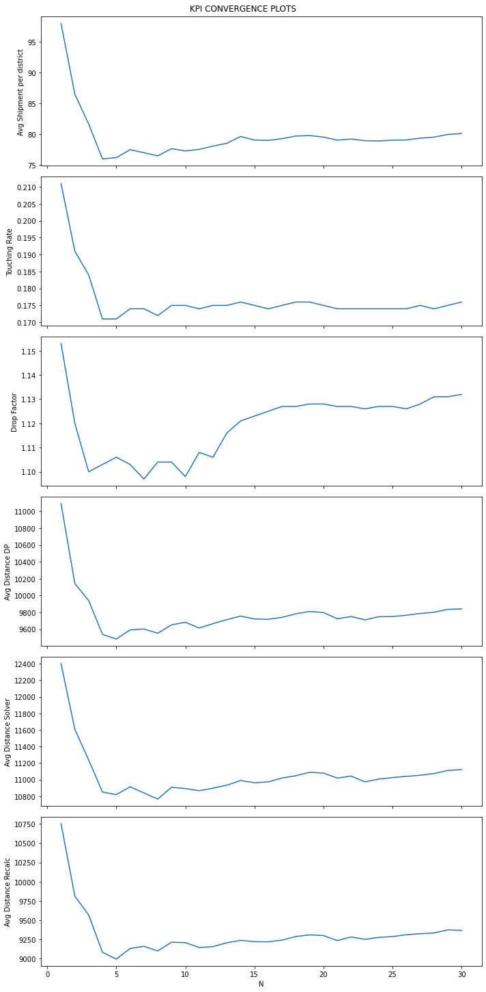
Evaluation of Convergence of KPI values for sizes of N
KPI_Warmsen_31604-09_Monday_5

Slide 4
Equal Shipments Scenarios

Slide 5
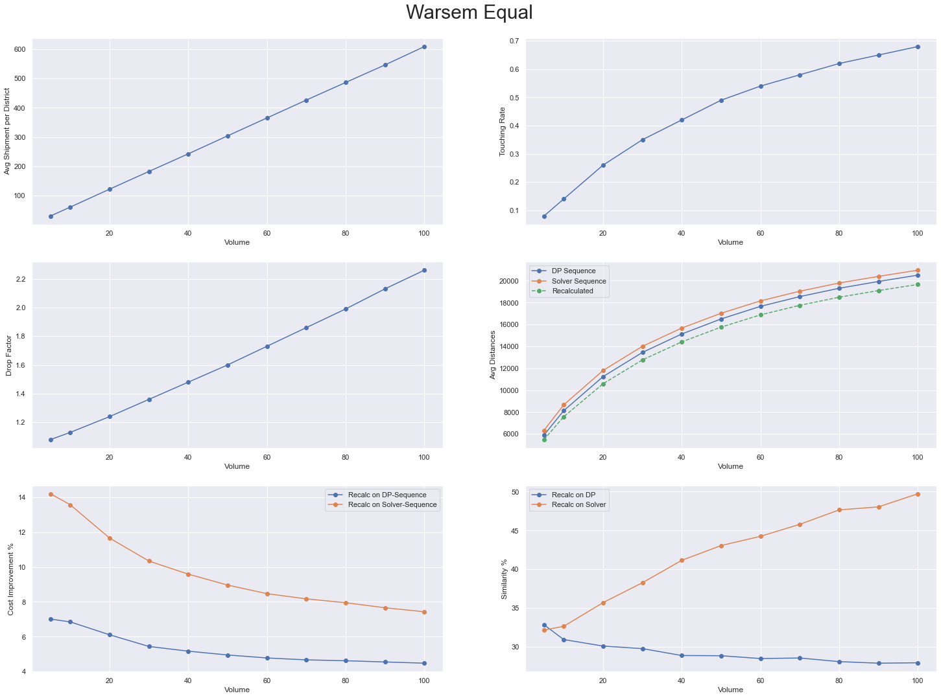

Slide 6
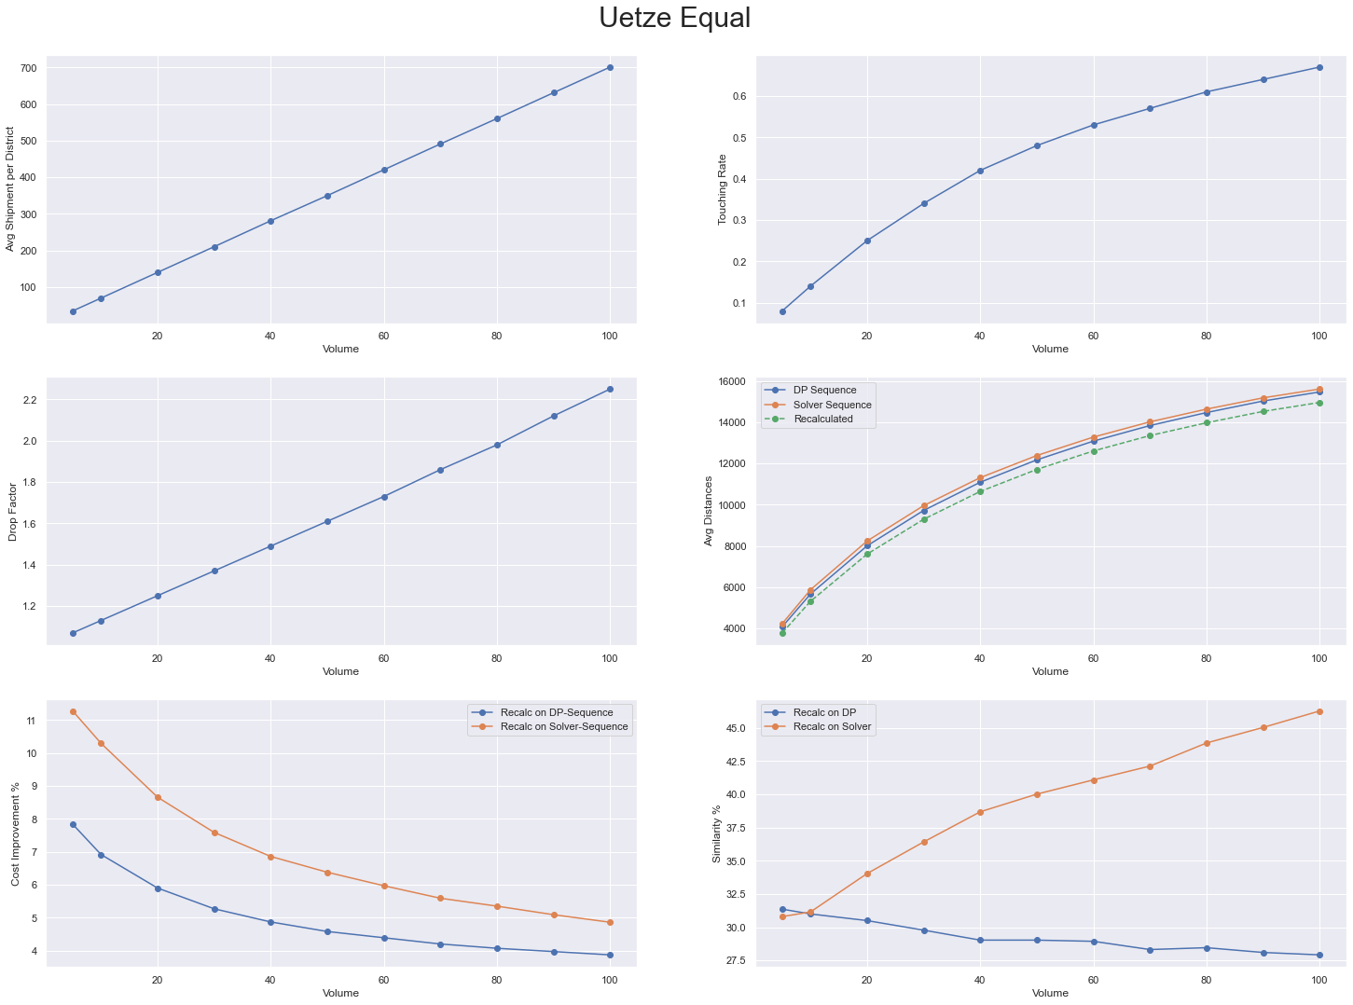

Slide 7
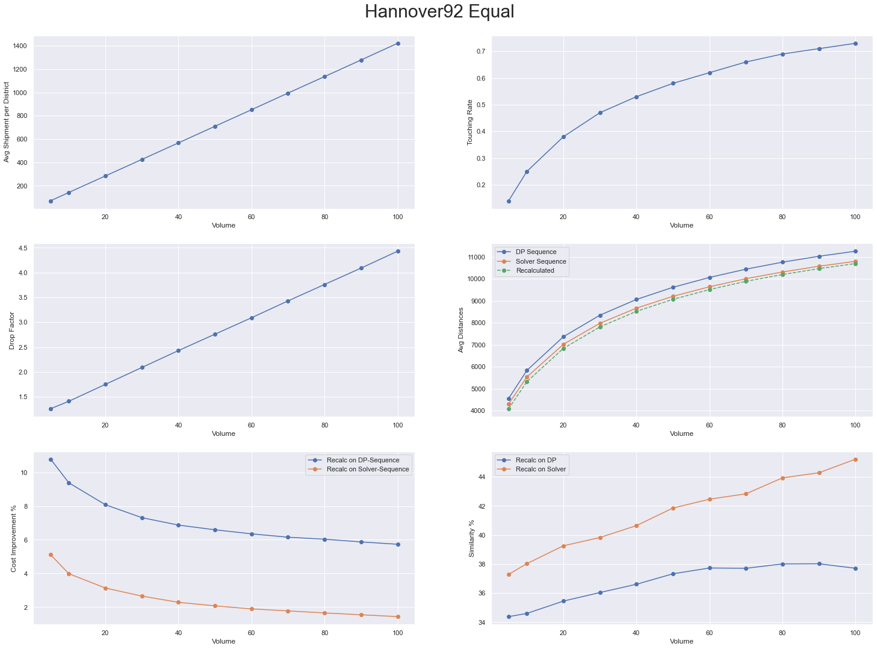

Slide 8
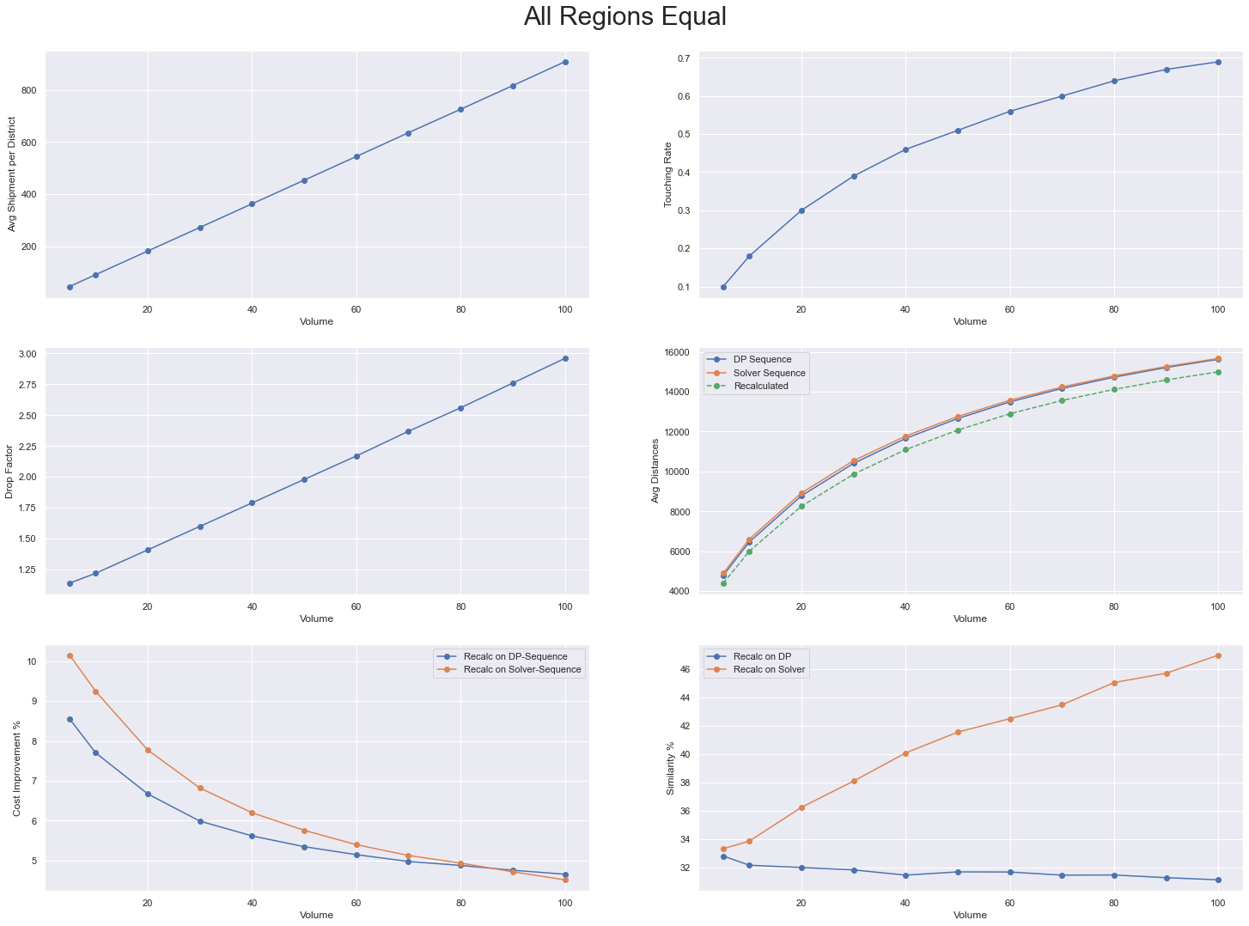

Slide 9
Unequal Shipments Scenarios

Slide 10
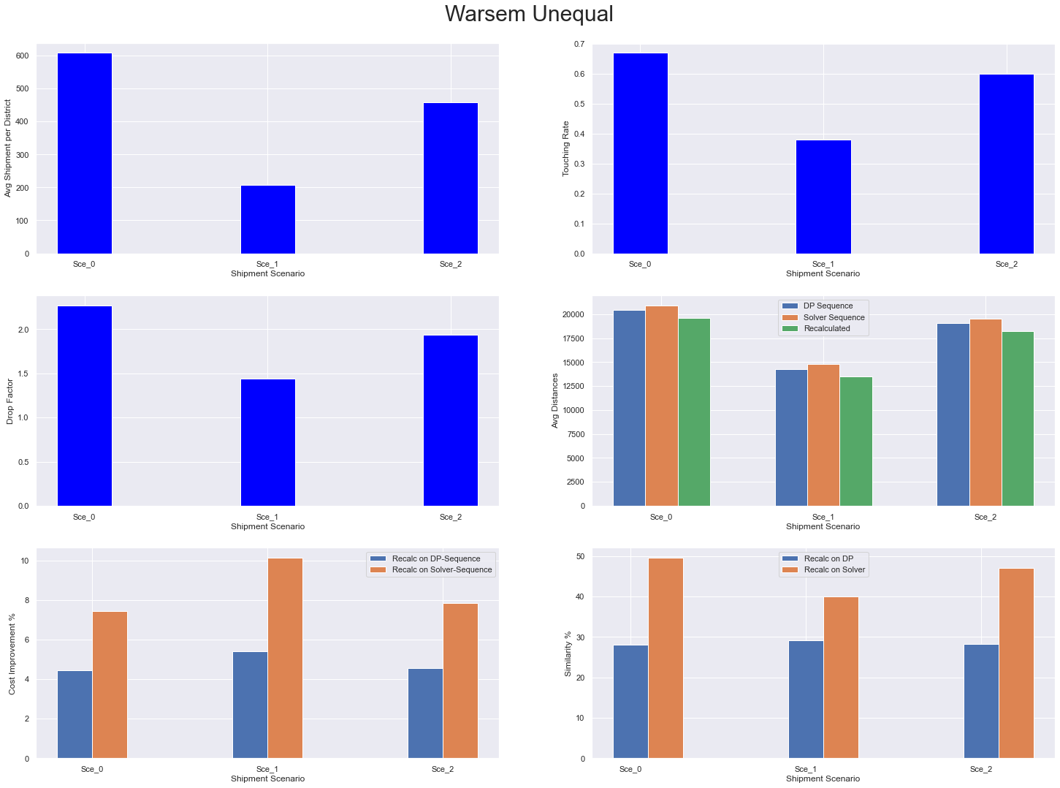

Slide 11
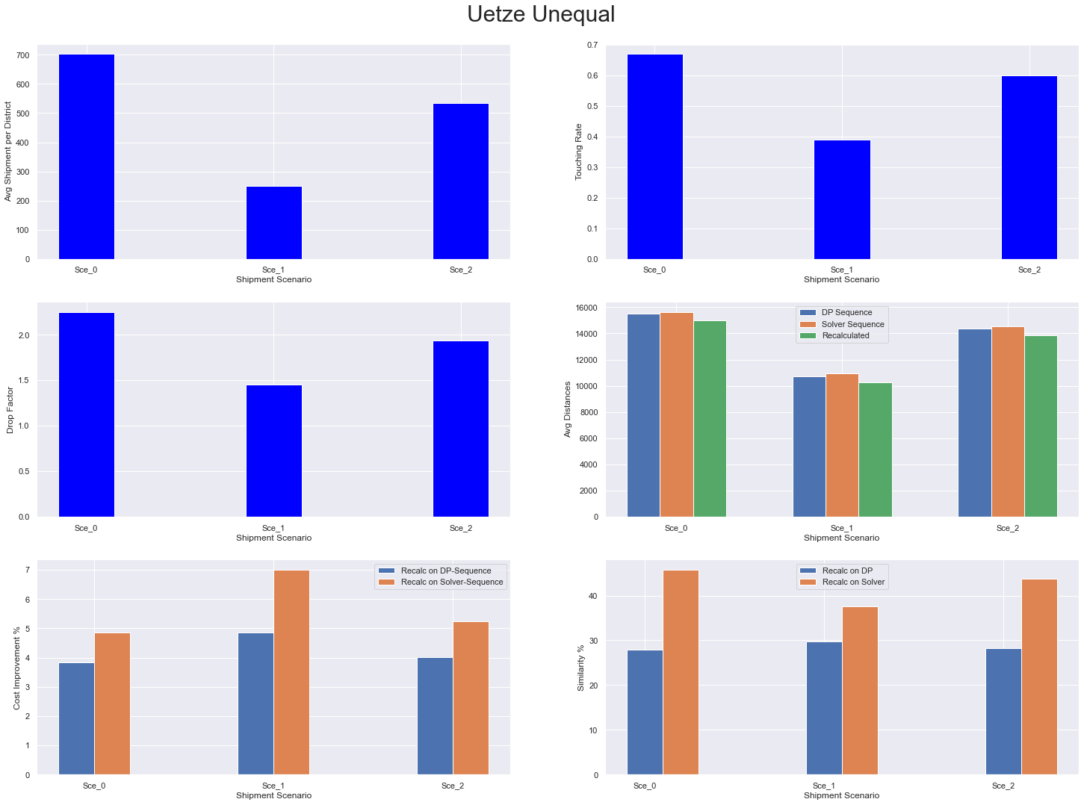

Slide 12
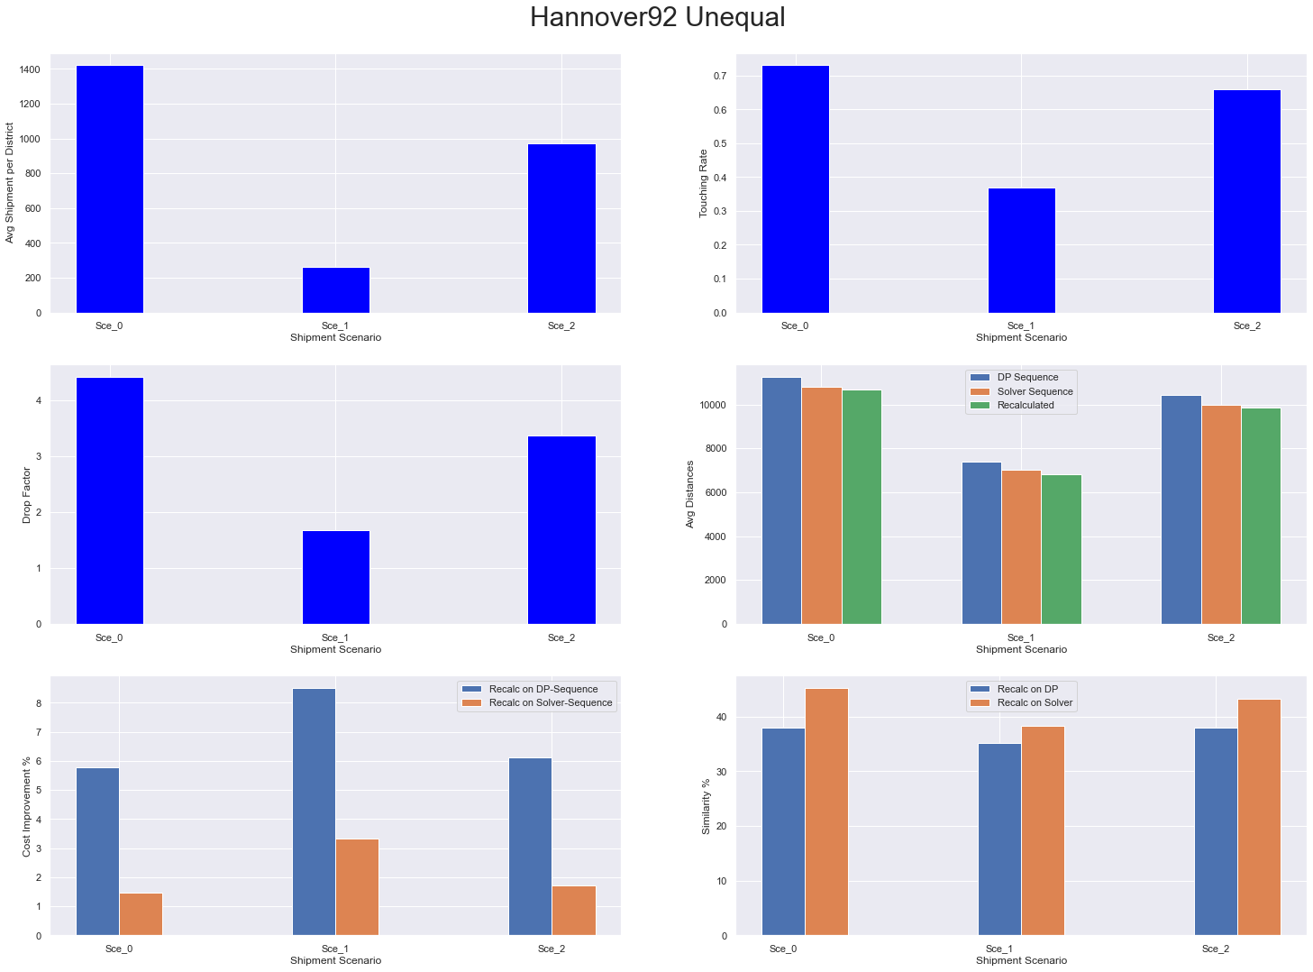

Slide 13
